Slide 1

IBM Data Science Project on SpaceX Dataset
Zijing He

Slide 2
Executive Summary
I conducted an extensive analysis of SpaceX Falcon 9 data aimed at predicting the successful landing of the first stage. This involved thorough data analysis, visualization, and the application of various machine learning techniques. I assessed failure rates and compared them based on different parameters, including launch sites. Additionally, I trained machine learning models on the data to facilitate predictions. Furthermore, I conducted comparisons among different machine learning models to identify the most suitable one for our dataset. Additionally, I determined the parameters that have the most significant impact on model performance.

Slide 3
Introduction
SpaceX offers Falcon 9 rocket launches on its website at a cost of 62 million dollars, significantly less than other providers whose costs can exceed 165 million dollars per launch. The primary reason for this cost difference is SpaceX's ability to reuse the first stage of the rocket. Therefore, predicting the successful landing of the first stage is crucial in determining the overall launch cost. This information becomes valuable when other companies consider bidding against SpaceX for a rocket launch contract.

Slide 4
Data collection
SpaceX offers an API that provides access to data for processing and analysis. Utilizing this API, I retrieve relevant data and complement it by scraping information from Wikipedia pages. I leverage the requests library to send Get requests to the API and employ the BeautifulSoup library for web scraping tasks to extract data from Wikipedia pages
Wrangling methodology
clean the data and remove anomalies from it
Perform exploratory data analysis (EDA) using visualization and SQL
Perform interactive visual analytics using Folium and Plotly Dash
Perform predictive analysis using classification models
I use built-in libraries to build the model and use Grid Search to get the best parameters for the model to get maximum accuracy

Slide 5

EDA and interactive visual analytics methodology
I utilize various visualization techniques to analyze the data:
Employing a scatter plot, I illustrate the correlation between different variables.
Utilizing a bar chart, I depict the success rates for each orbit.
Through a line chart, I track the annual success rates.
In addition to visualization, I employ SQL queries to extract insightful information:
I retrieve the total payload mass carried by NASA's Commercial Resupply Services (CRS).
Analyzing booster version F9 v1.1, I determine the average payload mass it carries.
I identify the date of the first successful landing.
By analyzing mission outcomes, I ascertain the total number of successful and failed missions.
Lastly, I identify the booster versions that have transported the maximum payload mass.

Slide 6
predictive analysis methodology
After acquiring the data, I standardize it to ensure uniformity. Subsequently, I partition the data into training and testing sets. I proceed to evaluate various models including KNN, SVM, Decision Tree, Logistics Regression, etc., leveraging Grid Search by passing parameters lists. Upon evaluation, I determine that the decision tree model outperforms others, exhibiting superior accuracy.

Slide 7
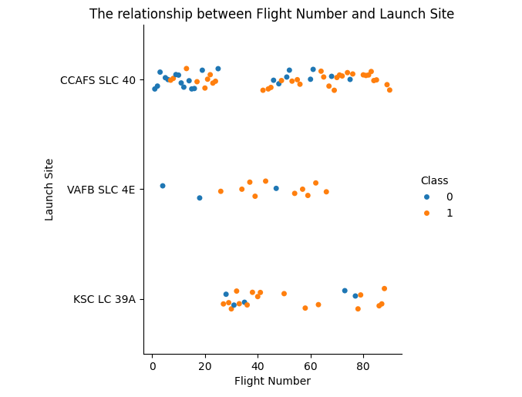
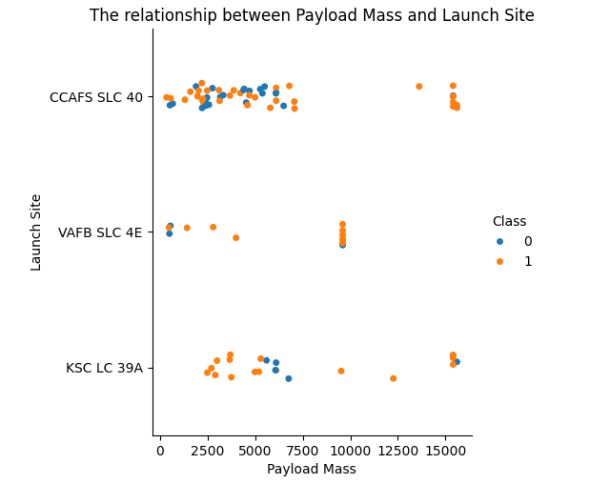
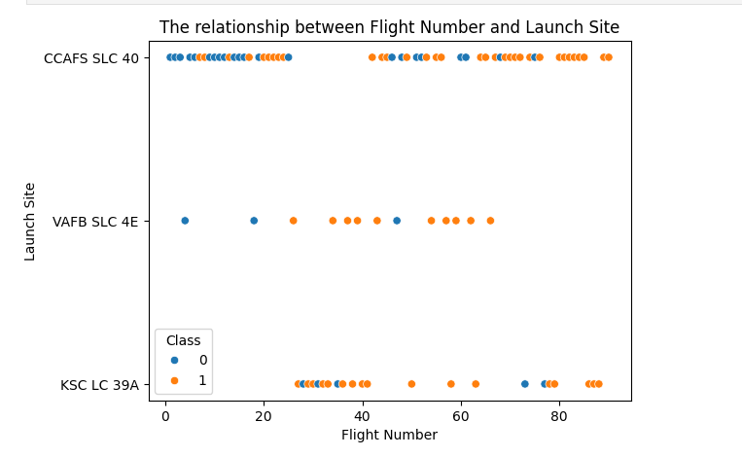
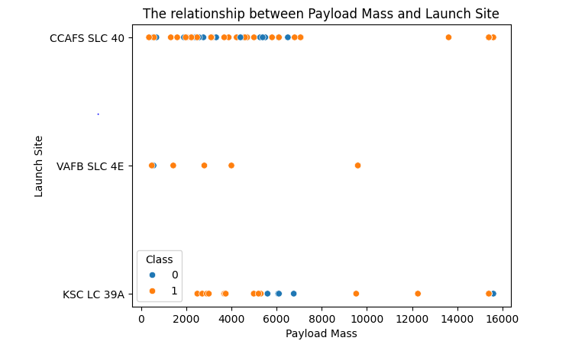
EDA with visualization results

Slide 8
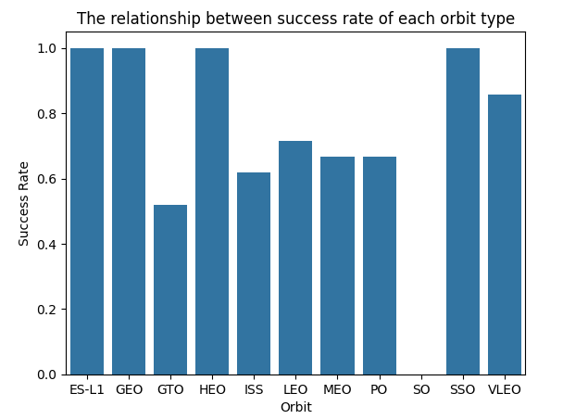
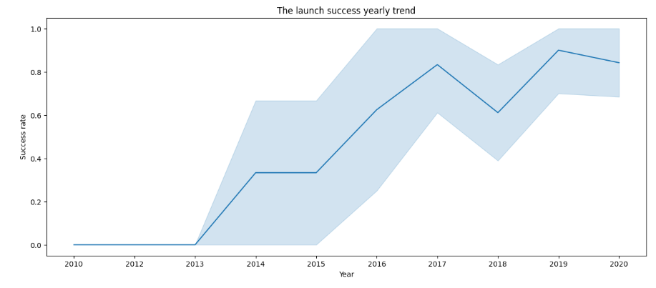
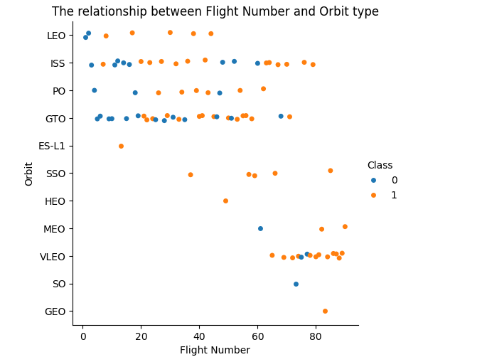
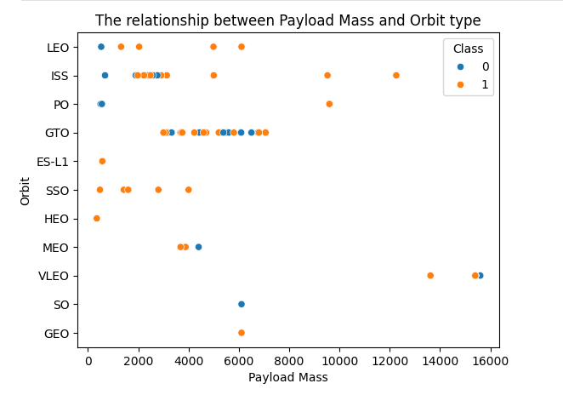
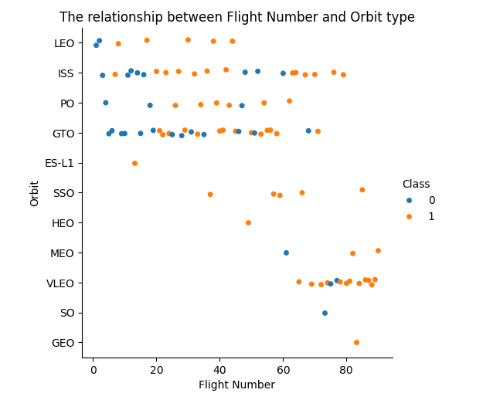
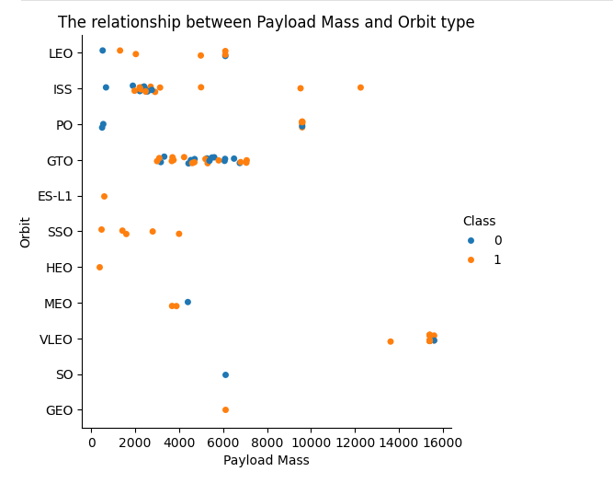

Slide 9
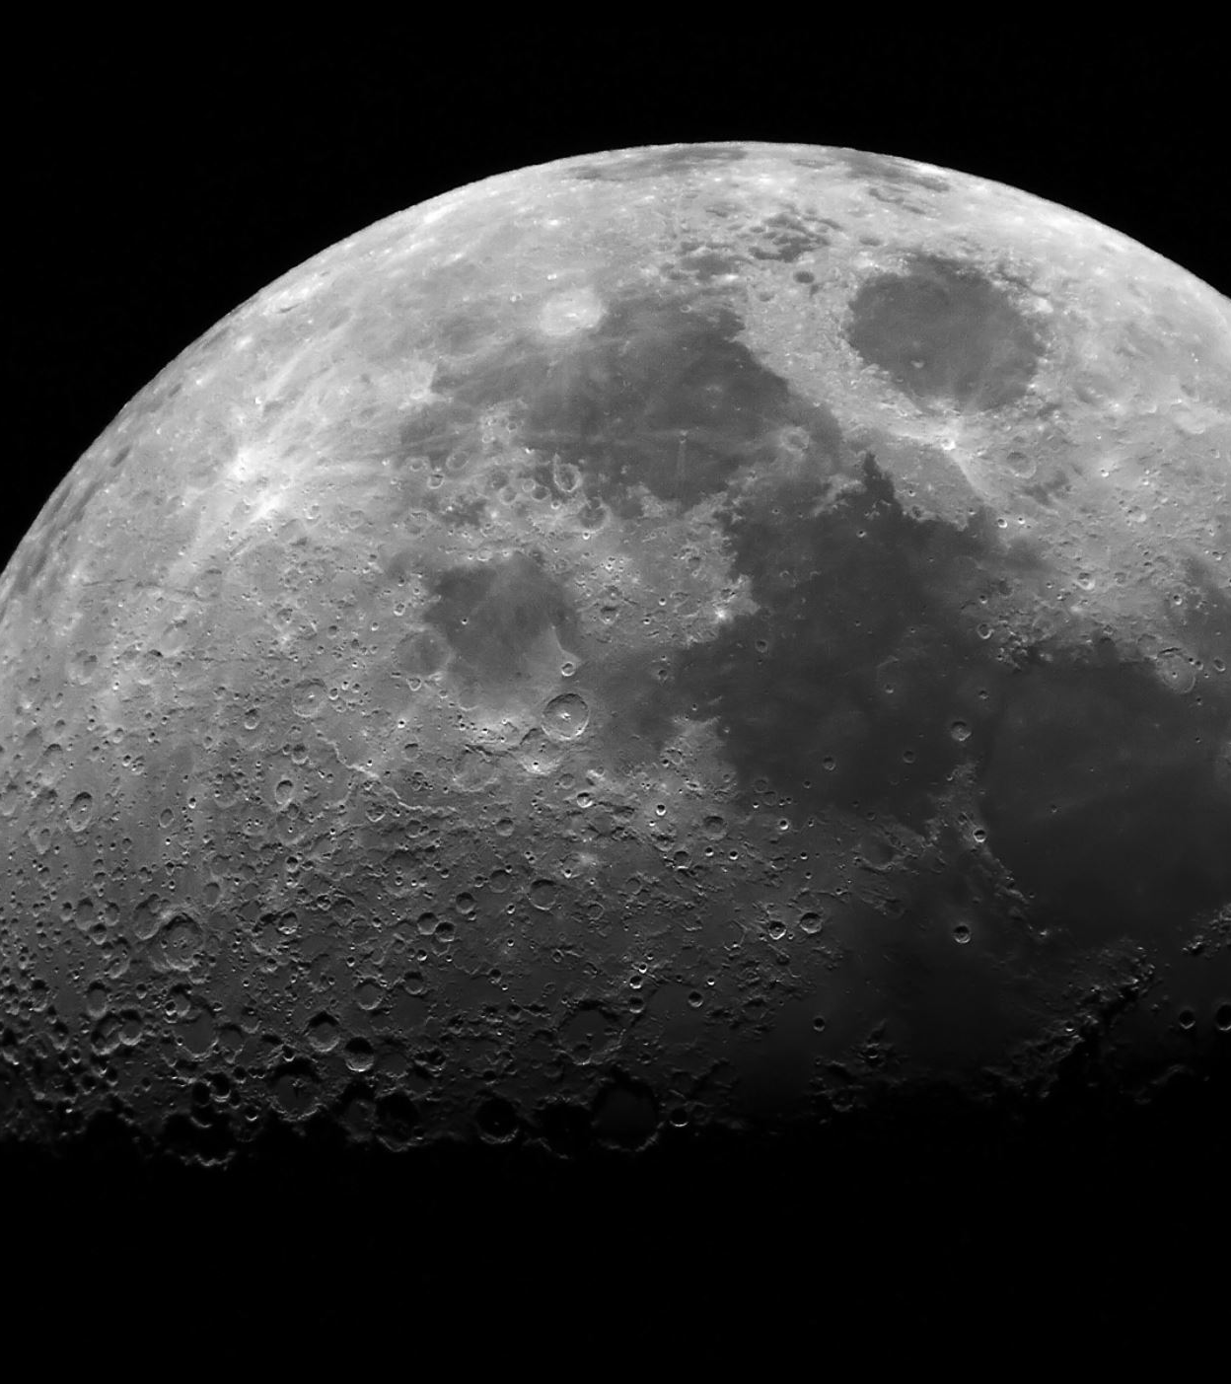
EDA with SQL
I use SQL to get the total payload mass carried by NASA (CRS).
I also checked the average payload mass carried by booster version F9 v1.1.
I check the date of the first successful landing outcome.
I check the total number of successful and failed mission outcomes.
I display the booster versions which have carried maximum payload mass.

Slide 10
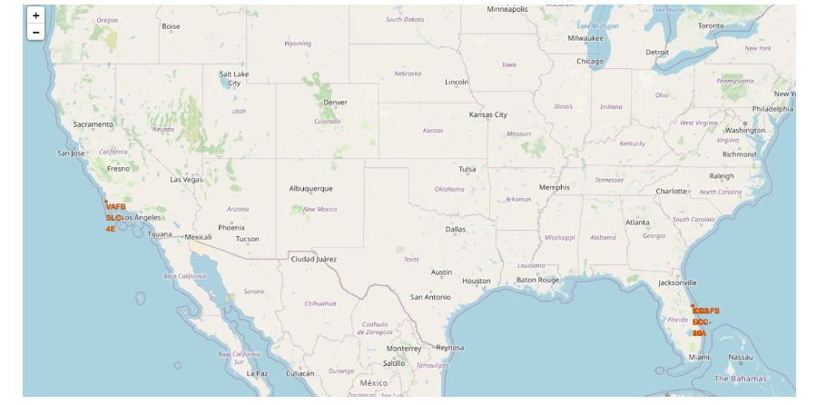
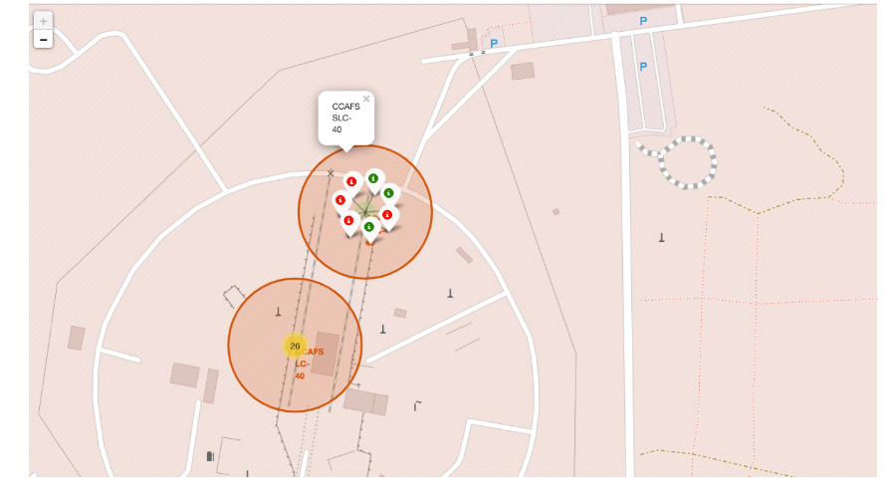
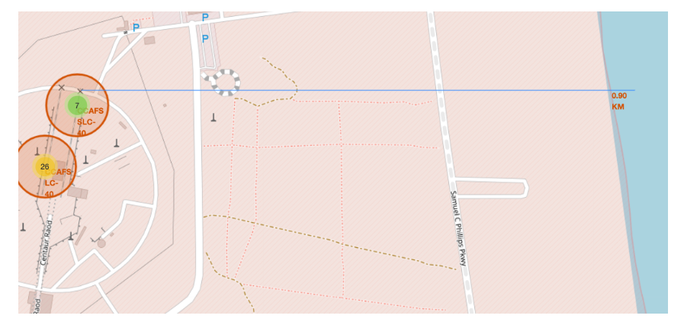
Interactive map with Folium

Slide 11
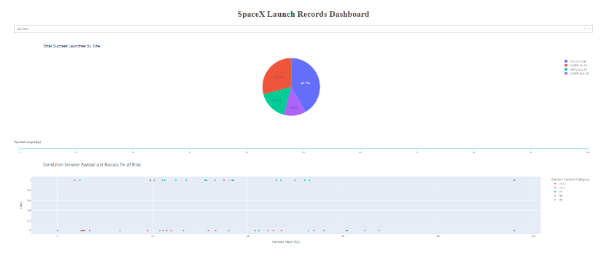
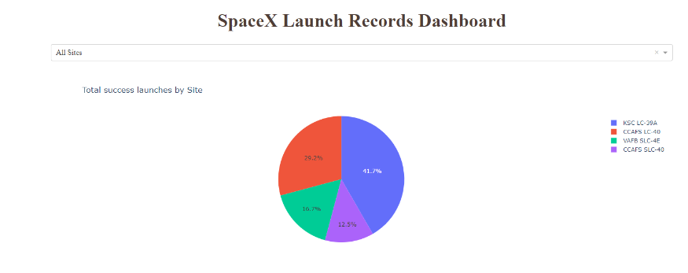
Plotly Dash

Slide 12

Predictive analysis result
I begin by retrieving the data and standardizing it to ensure consistency. Next, I partition the data into training and testing sets.
Subsequently, I assess various models including KNN, SVM, Decision Tree, Logistic Regression, etc., employing Grid Search by passing parameter lists.
Following evaluation, I conclude that the decision tree model outperforms others, demonstrating superior accuracy.

Slide 13

Conclusion
In data analysis I found a key point that the success rate is increasing year by year.
I’ve found through the dashboard that the 6K-8K payload range has the lowest success rates.
We can see that using Grid Search we can easily get the best parameters for the model and also check the best model by using one by one and better here (For this dataset) is Decision Tree as it is providing the highest accuracy.
KSC LC-39A has the largest successful launches.
CCAFS SLC-40 has the highest launch success rate.
The payload range of 2K-4K has the highest launch success rate.
F9 booster version, FT has the highest launch success rate.

